Slide 1


Determinants of prices of the German second-hand automobile market: the case of BMW
Academic Methods - Quantitative Approaches
Chair of Banking and Finance
Prof. Dr. Peter Reichling
Minh Anh Vu
Matriculation number: 25613
Date: 28 Jan 2021

Slide 2
Academic method - Quantitative approach
Agenda
Determinants of prices of used cars
Focus of Presentation
1
    Motivation
2
    Sample collection and descriptive statistics
3
    Methodology
4
    Regression result
5
    Conclusion

Slide 3
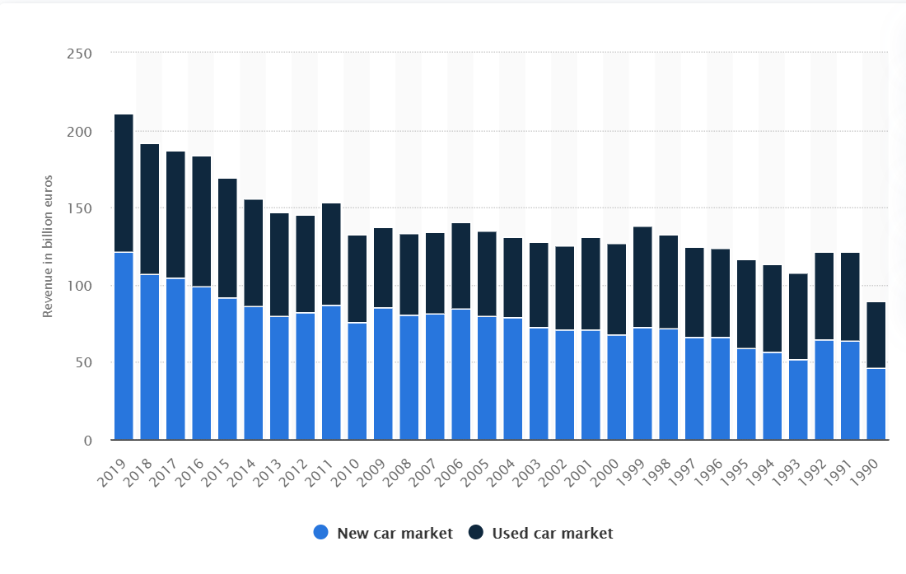
Academic method - Quantitative approach
Motivation
Sample
Methodology
Regression result
Limitation
Motivation
Revenue of the used and new car markets in Germany from 1990 to 2019
(in billion euros)
Source: Statista.com

Slide 4
Academic method - Quantitative approach
Motivation
Sample
Methodology
Regression result
Limitation
Data collection process
A total of 395 cross-sectional data was collected
1. Specify experimental object
3. Collect data
Brand: BMW
Model: 3 Series (4 seats)
Body type: compact, coupe, off-road,
sedan and station wagon
Regional market: Germany
Car price
Number of km driven
Year of first registration
Horse power
Number of previous owners
Gear type (Automatic or Manual)
Fuel type (Gasoline or Diesel)
Fuel consumption per 100km
CO2 emission per km
2. Determine data source
4. Clean data
Source of data: autoscout24.com
Date of collection: 22nd Jan 2021
Identify and remove inaccurate data (2/395)
Remove information of cars having
less than 3/9 specifications available

Slide 5
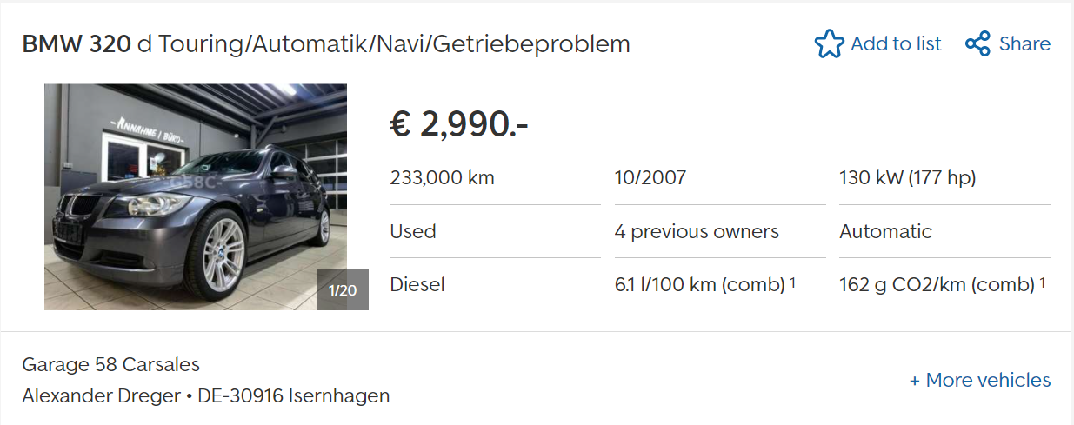
Academic method - Quantitative approach
Motivation
Sample
Methodology
Regression result
Limitation
Data collection process
A total of 395 cross-sectional data was collected
Example

Slide 6
Academic method - Quantitative approach
Motivation
Sample
Methodology
Regression result
Limitation
Descriptive statistics
General view
Information of a total 395 used cars are collected.
3 variables: previous owner number, fuel consumption and CO2 emission have missing data. The rest are complete. However, data missing randomly --> Do not bias result
Car price is the inspected variable. The highest price is 61,400 euro while the lowest is roughly 1,000 euro
Variable | Observation | Mean | Std. Dev. | Min | Max
price | 395 | 21.72 | 9.95 | 0.999 | 61.4
mlg | 395 | 83.29 | 60.59 | 3.17 | 364.29
year | 395 | 2015.37 | 4.79 | 1986 | 2020
age | 395 | 5.63 | 4.79 | 1 | 35
hp | 395 | 195.08 | 52.72 | 105 | 374
owner | 356 | 1.31 | 0.6 | 1 | 4
con | 343 | 5.4 | 2.198 | 0 | 10.6
ems | 348 | 136.47 | 51.2 | 0 | 255
gear | 395
fuel | 395

Slide 7
Academic method - Quantitative approach
Motivation
Sample
Methodology
Regression result
Limitation
Descriptive statistics
Correlation matrix
 | mlg | age | hp | owner | dgear | dfuel | con | ems
mlg | 1
age | 0.6611 | 1
hp | 0.0626 | -0.1275 | 1
owner | 0.4137 | 0.538 | -0.0593 | 1
dgear | -0.2798 | -0.4487 | 0.3328 | -0.2476 | 1
dfuel | -0.0249 | -0.319 | -0.1178 | -0.1646 | 0.1174 | 1
con | 0.229 | 0.5124 | 0.359 | 0.2416 | -0.1016 | -0.7163 | 1
ems | 0.2848 | 0.5257 | 0.3927 | 0.2372 | -0.0833 | -0.538 | 0.9472 | 1

Slide 8
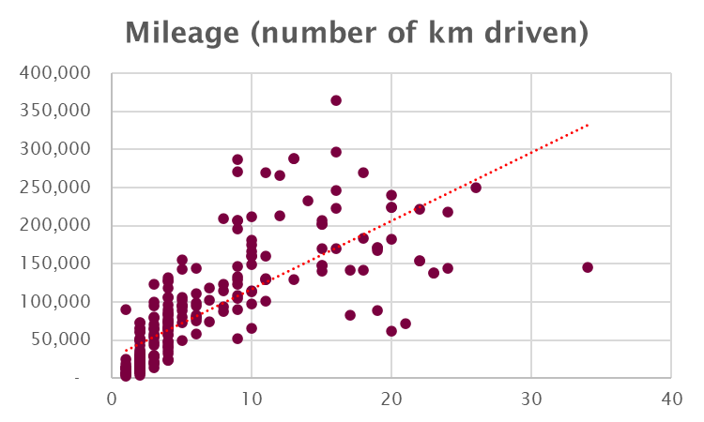
Academic method - Quantitative approach
Motivation
Sample
Methodology
Regression result
Limitation
Descriptive statistics
Mileage
As expected, the older the car is, the longer mileage it had run.
In our sample, the longest mileage recorded is 364,290 km, compared to the shortest run of 3,170 km

Slide 9
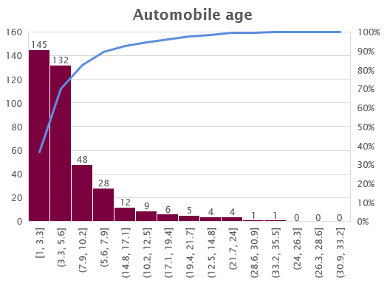
Academic method - Quantitative approach
Motivation
Sample
Methodology
Regression result
Limitation
Descriptive statistics
Age
All cars in the sample are less than 35 year-old.
70% of them are from 1 to 6 year-old

Slide 10
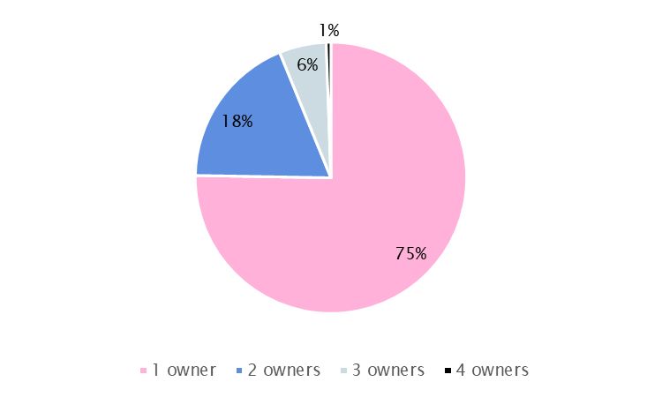
Academic method - Quantitative approach
Motivation
Sample
Methodology
Regression result
Limitation
Descriptive statistics
Number of previous owner
75% of cars from the sample are first-time resold.
The finding is aligned with the fact that majority of the listed second-hand cars are relatively “new” (1-6 year-old)

Slide 11
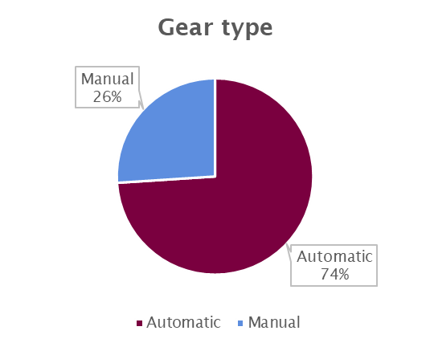
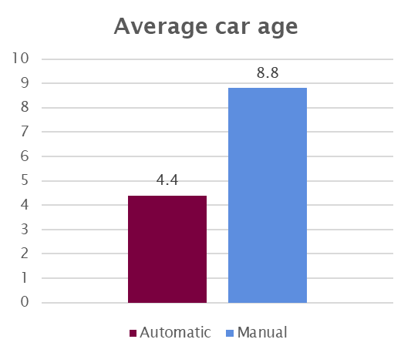
Academic method - Quantitative approach
Motivation
Sample
Methodology
Regression result
Limitation
Descriptive statistics
Automatic/Manual gear
74% of cars in the sample are automatic.
Average age of automatic car group is only half of that of manual cars
→ Newly manufactured cars might prefer automatic transmission than manual transmission

Slide 12
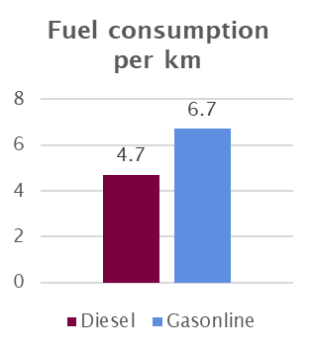
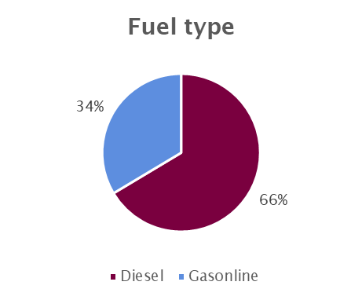
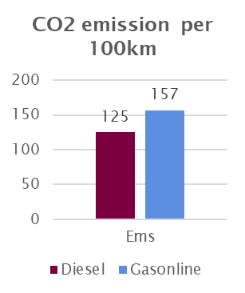
Academic method - Quantitative approach
Motivation
Sample
Methodology
Regression result
Limitation
Descriptive statistics
Fuel consumption and CO2 emission
66% of cars from the sample diesel fueled cars
Diesel cars also consumption less fuel per km as well as produce less CO2 emission compared with that of gasoline engine cars

Slide 13
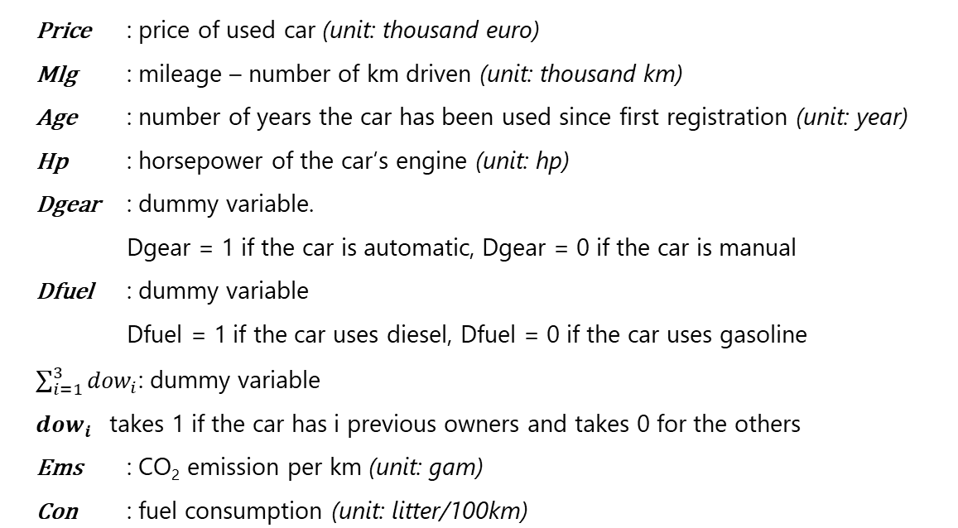
Academic method - Quantitative approach
Motivation
Sample
Methodology
Regression result
Limitation
Methodology
Model specification

Slide 14
Academic method - Quantitative approach
Motivation
Sample
Methodology
Regression result
Limitation
Regression result
without robust SD and discussion
regress price mlg age hp dgear dfuel dow1 dow2 dow3 con ems
price | Coef. | Std. Err. | t | P>t | [95% Conf. | Interval]
mlg | -0.076 | 0.006 | -12.660 | 0.000 | -0.087 | -0.064
age | -0.860 | 0.117 | -7.360 | 0.000 | -1.089 | -0.630
hp | 0.058 | 0.006 | 9.580 | 0.000 | 0.046 | 0.070
dgear | 2.104 | 0.660 | 3.190 | 0.002 | 0.807 | 3.402
dfuel | 1.699 | 1.008 | 1.690 | 0.093 | -0.283 | 3.682
dow1 | 1.423 | 0.954 | 1.490 | 0.137 | -0.453 | 3.300
dow2 | -0.695 | 0.992 | -0.700 | 0.484 | -2.646 | 1.256
dow3 | 0.462 | 1.325 | 0.350 | 0.727 | -2.144 | 3.068
con | 1.563 | 0.997 | 1.570 | 0.118 | -0.398 | 3.524
ems | -0.020 | 0.040 | -0.490 | 0.624 | -0.098 | 0.059
_cons | 12.295 | 2.120 | 5.800 | 0.000 | 8.125 | 16.465
Number of obs | 342
Adj R-squared | 0.8049
F(10, 331) | 141.67
Running regression without robust standard deviation, 4 factors present significant impacts on price (at 5% significant level).
Adjusted R-square: 80.5% of price variation are explained by the regression model

Slide 15
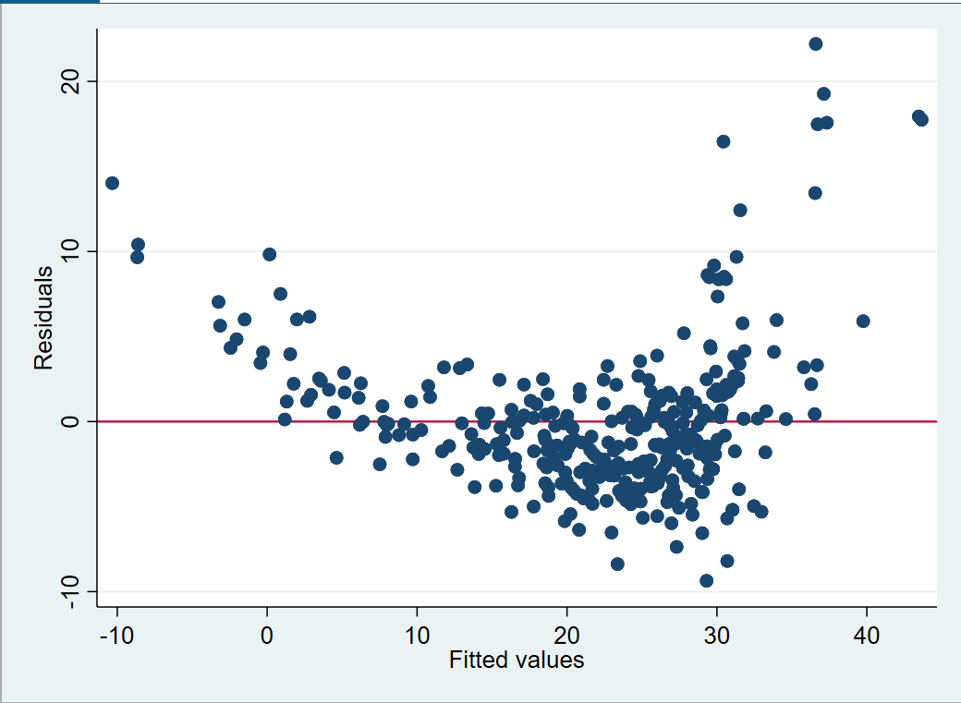
Academic method - Quantitative approach
Motivation
Sample
Methodology
Regression result
Limitation
Robustness check
Heteroskedasticity problem?
Residual variance
estat hettest
Breusch-Pagan / Cook-Weisberg test for heteroskedasticity
Ho: Constant variance
Variables: fitted values of price
chi2(1) = 45.27
Prob > chi2 = 0.0000
If the model is well-fitted, there should be no pattern to the residuals plotted against the fitted values
However, the graph show a convergence tendency towards lower right-hand side of fitted values
Breusch-Pagan / Cook-Weisberg test with p-value = 0.0000 (<5%) also reject the constant variance hypothesis.

Slide 16
Academic method - Quantitative approach
Motivation
Sample
Methodology
Regression result
Limitation
Robustness check
Multicollinearity problem?
Variable | VIF | 1/VIF
con | 28.040 | 0.036
ems | 19.800 | 0.051
age | 4.320 | 0.231
dfuel | 3.780 | 0.264
dow1 | 3.330 | 0.300
dow2 | 2.350 | 0.426
mlg | 2.180 | 0.458
hp | 1.810 | 0.552
dow3 | 1.440 | 0.694
dgear | 1.380 | 0.724
Mean VIF | 6.84
As a rule of thumb, multicollinearity is a problem if VIFs are higher than 10
The mean VIF of 6.84 indicates no multicollinearity problem between independent variables

Slide 17
Academic method - Quantitative approach
Motivation
Sample
Methodology
Regression result
Limitation
Regression result
with robust SD and discussion
regress price mlg age hp dgear dfuel dow1 dow2 dow3 con ems, robust
price | Coef. | Robust Std. Err. | t | P>t | [95% Conf. | Interval]
mlg | -0.076 | 0.007 | -10.830 | 0.000 | -0.089 | -0.062
age | -0.860 | 0.088 | -9.780 | 0.000 | -1.033 | -0.687
hp | 0.058 | 0.007 | 8.420 | 0.000 | 0.044 | 0.071
dgear | 2.104 | 0.499 | 4.220 | 0.000 | 1.123 | 3.085
dfuel | 1.699 | 0.893 | 1.900 | 0.058 | -0.057 | 3.456
dow1 | 1.423 | 0.769 | 1.850 | 0.065 | -0.089 | 2.935
dow2 | -0.695 | 0.742 | -0.940 | 0.350 | -2.153 | 0.764
dow3 | 0.462 | 1.147 | 0.400 | 0.687 | -1.794 | 2.718
con | 1.563 | 0.926 | 1.690 | 0.092 | -0.259 | 3.385
ems | -0.020 | 0.037 | -0.530 | 0.598 | -0.092 | 0.053
_cons | 12.295 | 2.086 | 5.890 | 0.000 | 8.191 | 16.398
R-squared | 0.8106
The model is well-explained the variation in prices of second-hand BMW car (81%)
Using robust SD, the impact of fuel type and “one previous owner” are significant at 10% level but not significant at 5% level.

Slide 18
Academic method - Quantitative approach
Motivation
Sample
Methodology
Regression result
Limitation
Regression result
with robust SD and discussion
regress price mlg age hp dgear dfuel dow1 dow2 dow3 con ems, robust
price | Coef. | Robust Std. Err. | t | P>t | [95% Conf. | Interval]
mlg | -0.076 | 0.007 | -10.830 | 0.000 | -0.089 | -0.062
age | -0.860 | 0.088 | -9.780 | 0.000 | -1.033 | -0.687
hp | 0.058 | 0.007 | 8.420 | 0.000 | 0.044 | 0.071
dgear | 2.104 | 0.499 | 4.220 | 0.000 | 1.123 | 3.085
dfuel | 1.699 | 0.893 | 1.900 | 0.058 | -0.057 | 3.456
dow1 | 1.423 | 0.769 | 1.850 | 0.065 | -0.089 | 2.935
dow2 | -0.695 | 0.742 | -0.940 | 0.350 | -2.153 | 0.764
dow3 | 0.462 | 1.147 | 0.400 | 0.687 | -1.794 | 2.718
con | 1.563 | 0.926 | 1.690 | 0.092 | -0.259 | 3.385
ems | -0.020 | 0.037 | -0.530 | 0.598 | -0.092 | 0.053
_cons | 12.295 | 2.086 | 5.890 | 0.000 | 8.191 | 16.398
In general, mileage and car age has negative influence on car price while horsepower and automatic transmission drive prices of used cars positively (as expected)
Example:
Hold other factors fixed, the BMW car that one year older is 860 euro cheaper.
Other factors fixed, an automatic BMW car is 2,104 euro more expensive than a BMW manual car

Slide 19
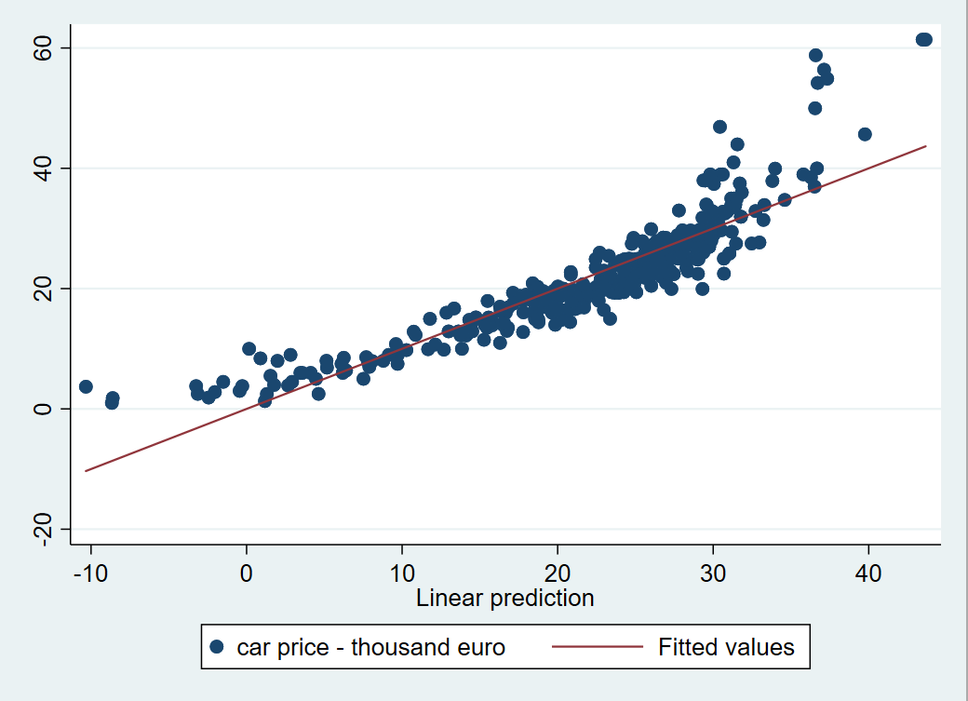
Academic method - Quantitative approach
Motivation
Sample
Methodology
Regression result
Limitation
Regression result
Graphic relationship: actual price and predicted price

Slide 20
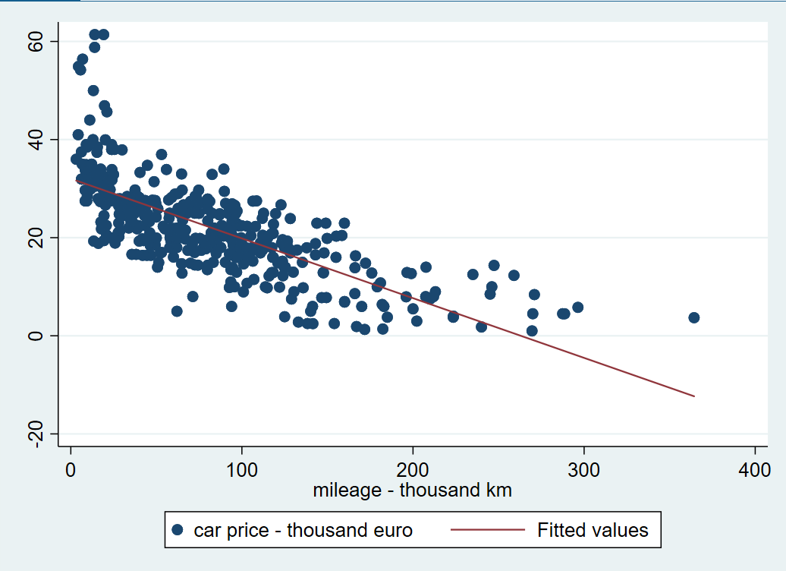
Academic method - Quantitative approach
Motivation
Sample
Methodology
Regression result
Limitation
Regression result
Graphic relationship: number of km driven and car price

Slide 21
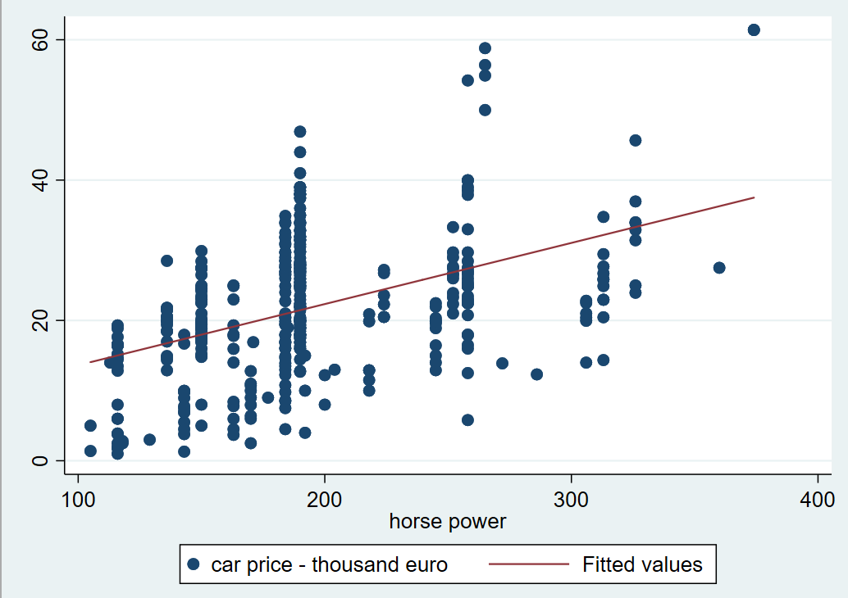
Academic method - Quantitative approach
Motivation
Sample
Methodology
Regression result
Limitation
Regression result
Graphic relationship: horsepower and car price

Slide 22
Academic method - Quantitative approach
Motivation
Sample
Methodology
Regression result
Limitation
LIMITATION
Limitation in sample size
Compared the market size of the German second-hand market (89 billion euro as of 2019), the sample size of 395 cars (8.5 million euro in total value) is unlikely to reflect the true relationship in population of BMW used car market.
Limitation in data source
Data are collected from autoscout.24, and not yet compared to other car dealer websites. This can lead to bias estimation

Slide 23
Academic method - Quantitative approach
THANK YOU

